Slide 1
Renewable Energy market analysis & projection (REMAP)
Data Collected through
Energy Acuity
Dodge Analytics
Industrial info Resources

Slide 2
Renewable energy Jobs for the 7th District consist of :
WIND
SOLAR
BATTERY STORAGE
OFFSHORE WIND (coming soon)

Slide 3
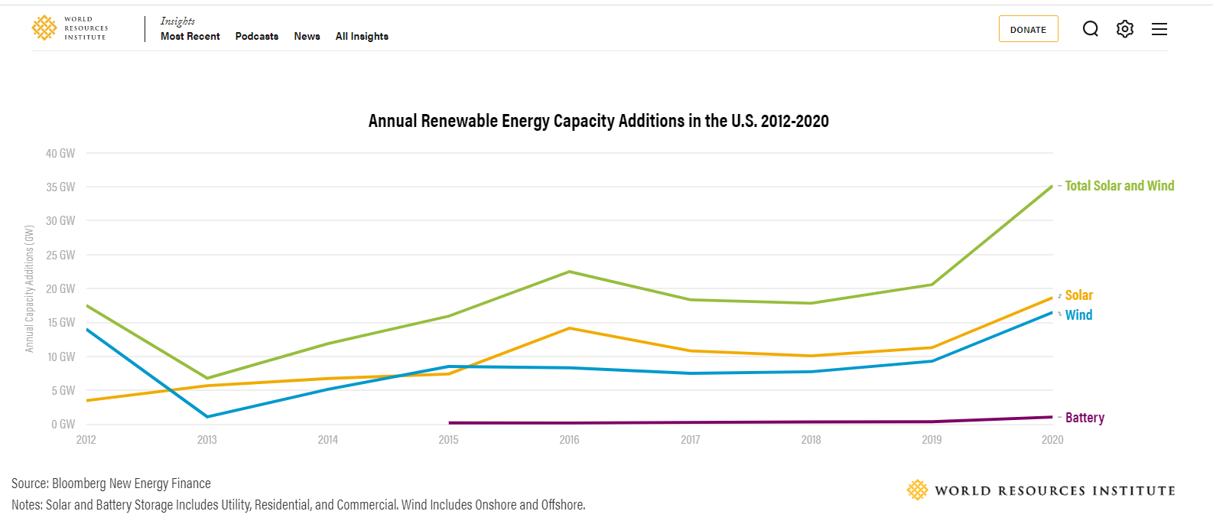

Slide 5
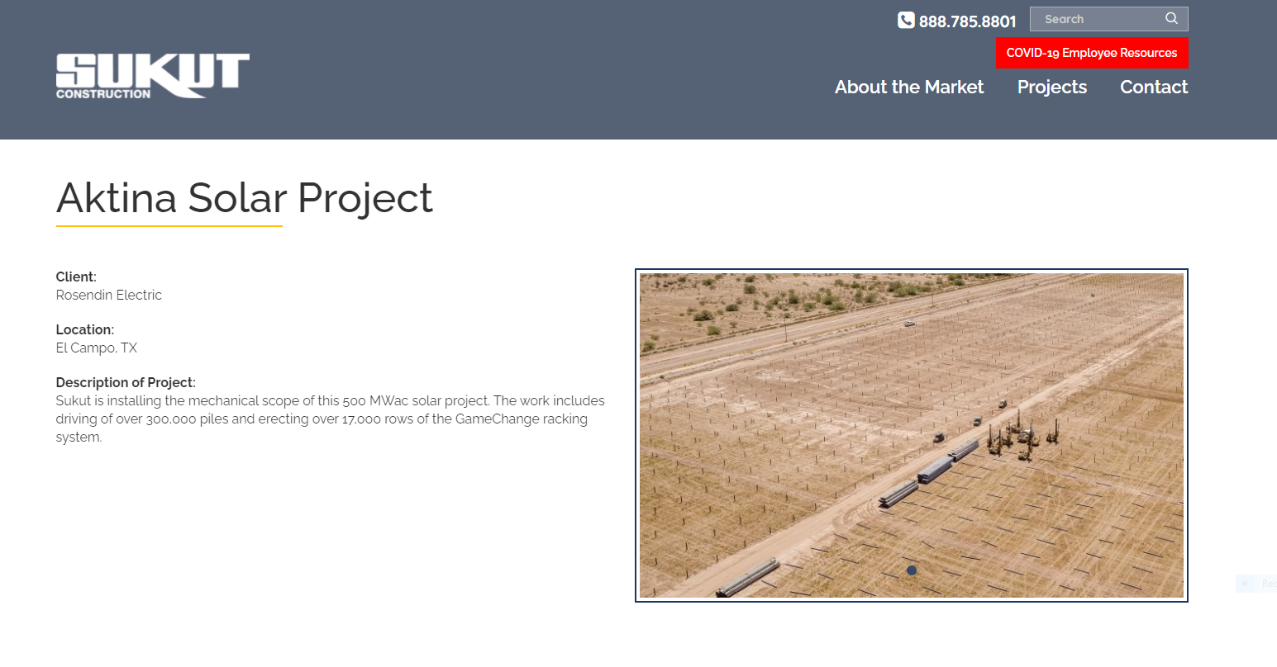
https://sukut.com/energy/projects/

Slide 6


Slide 7
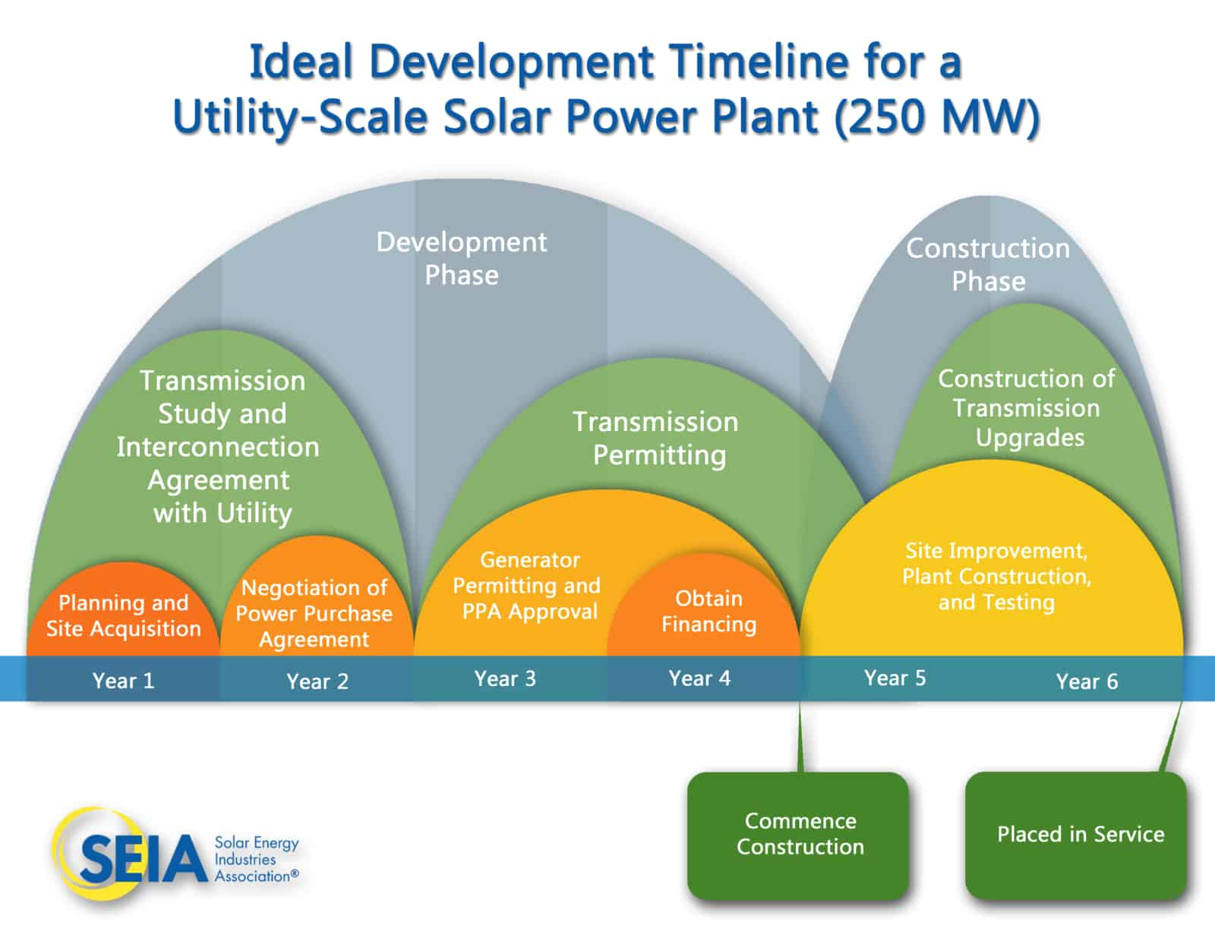

Slide 8
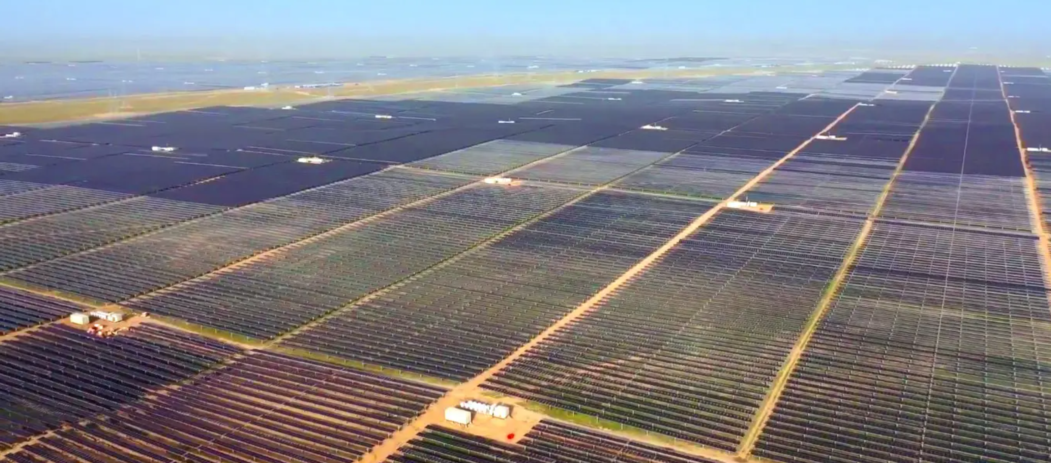
Solar Arrays require 7 acres of land per MW
There are 640 acres in a square mile. 1000 mw (1gw) requires 7,000 acres of land or 10.94 square miles

Slide 9
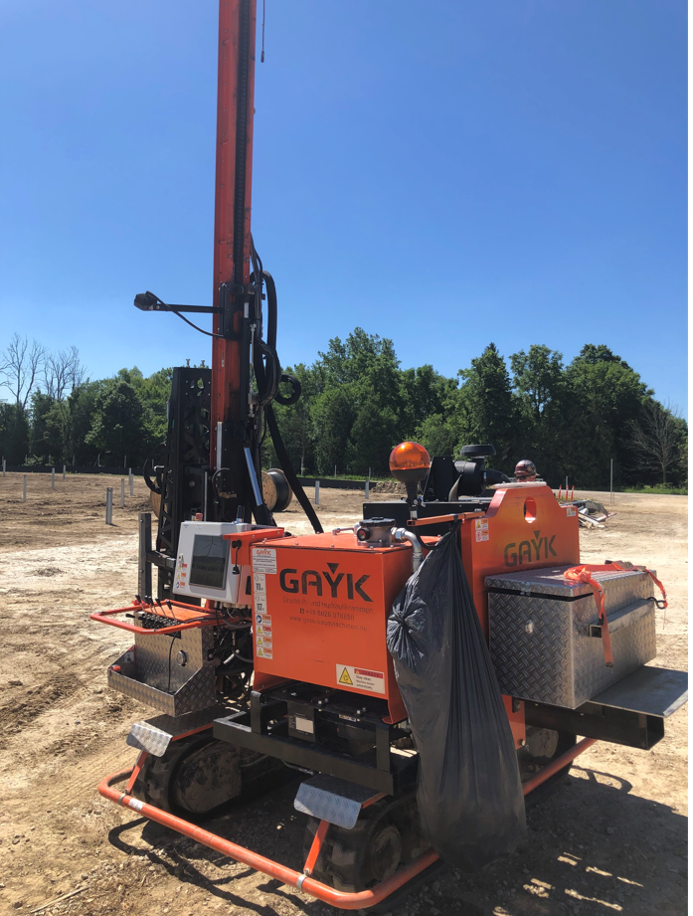
1 mw REQUIRES APPROXIMATELY 3,500 MAN-HOURS
The Post/rack and panel installation represents 60% of the 3500 hours/MW
POST
RACK
PANEL

Slide 10
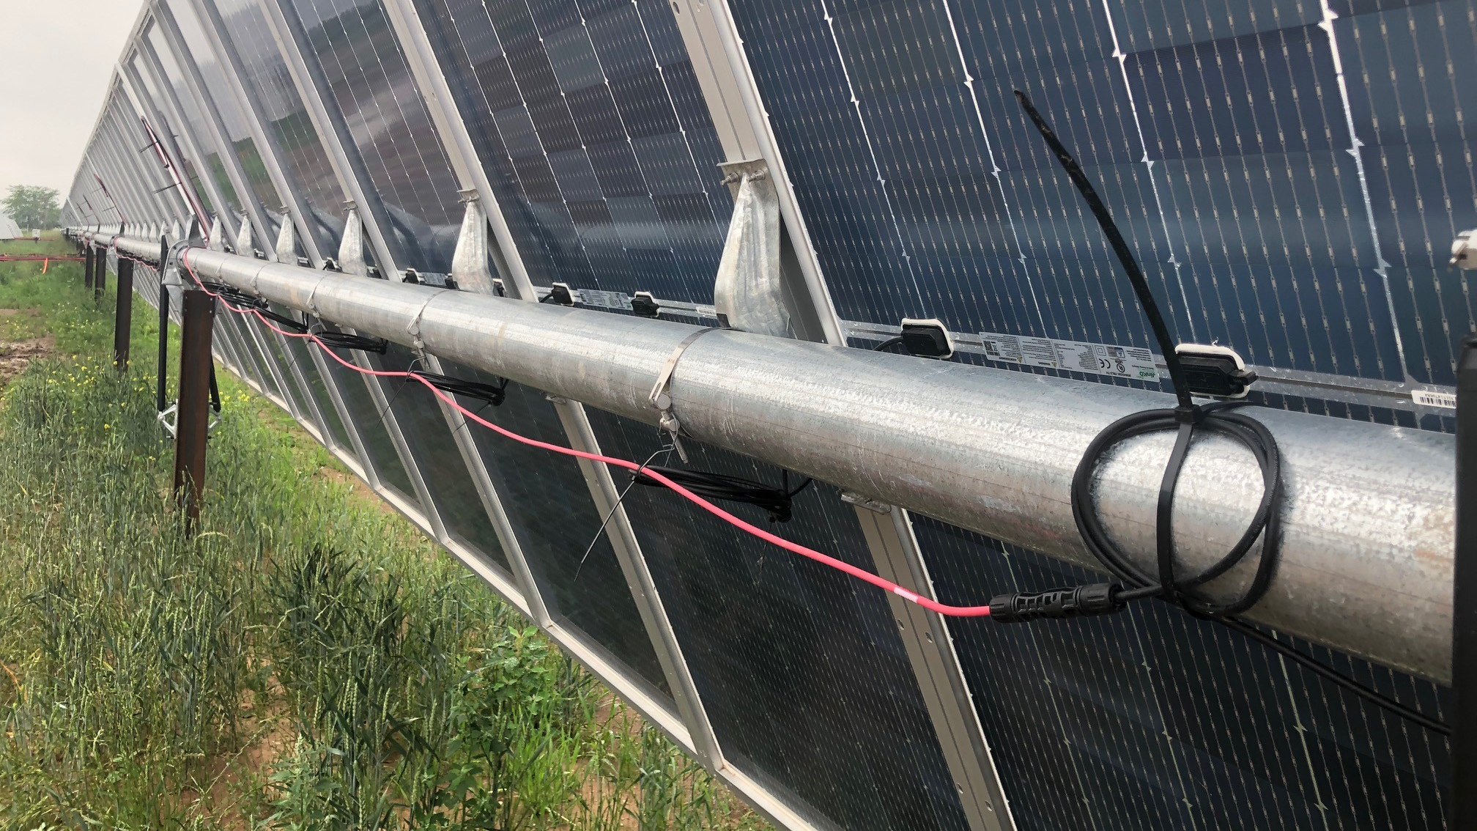
TORSION TUBE / MOUNTING BRACKET / PANELS

Slide 11
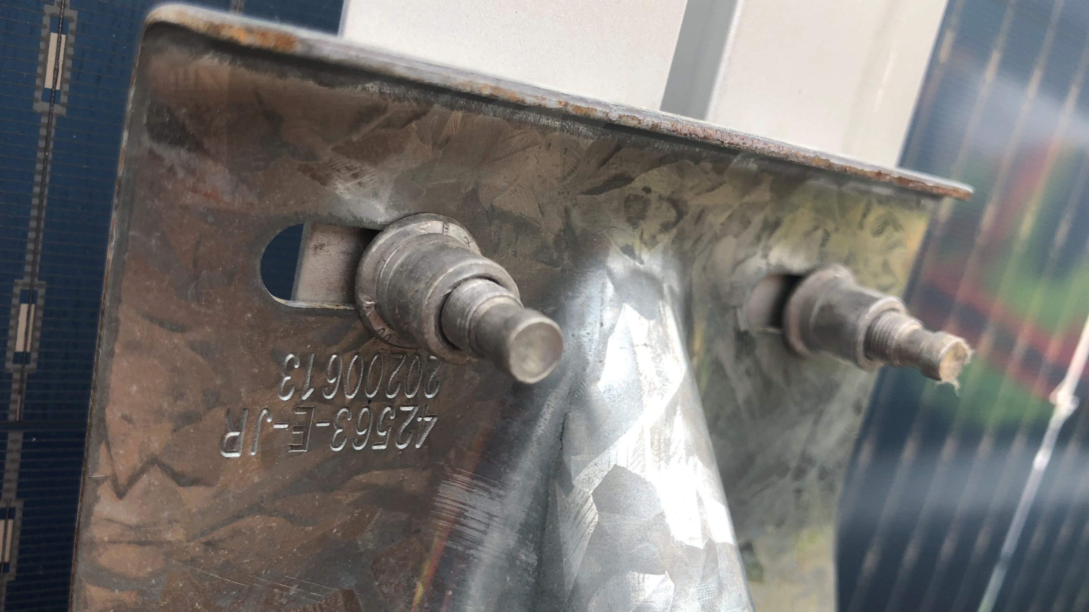
SOLAR RACK PANEL MOUNTING HARDWARE

Slide 12
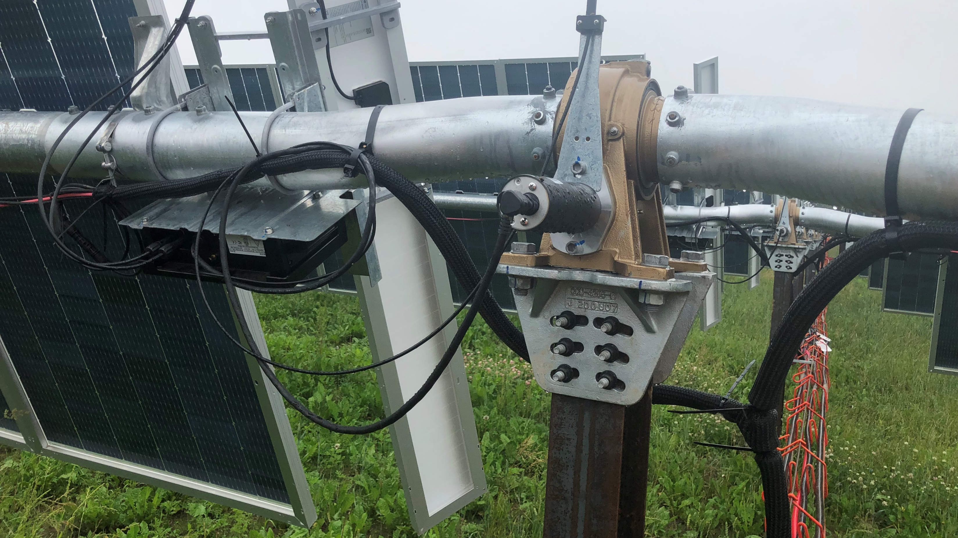
TORSION TUBE / ACTUATOR MOTOR / BATTERY / PANEL

Slide 13

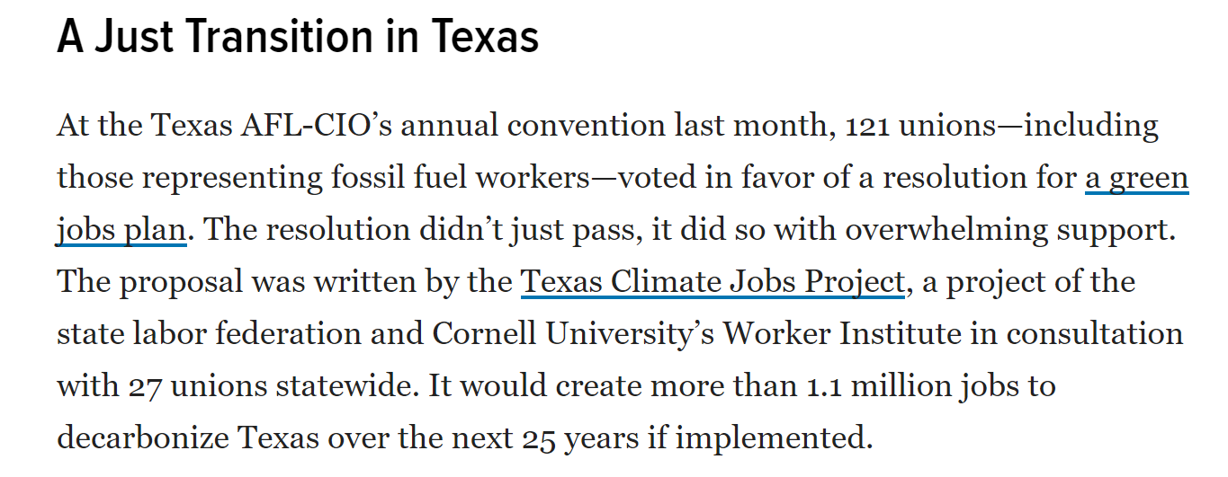

Slide 14


Slide 15
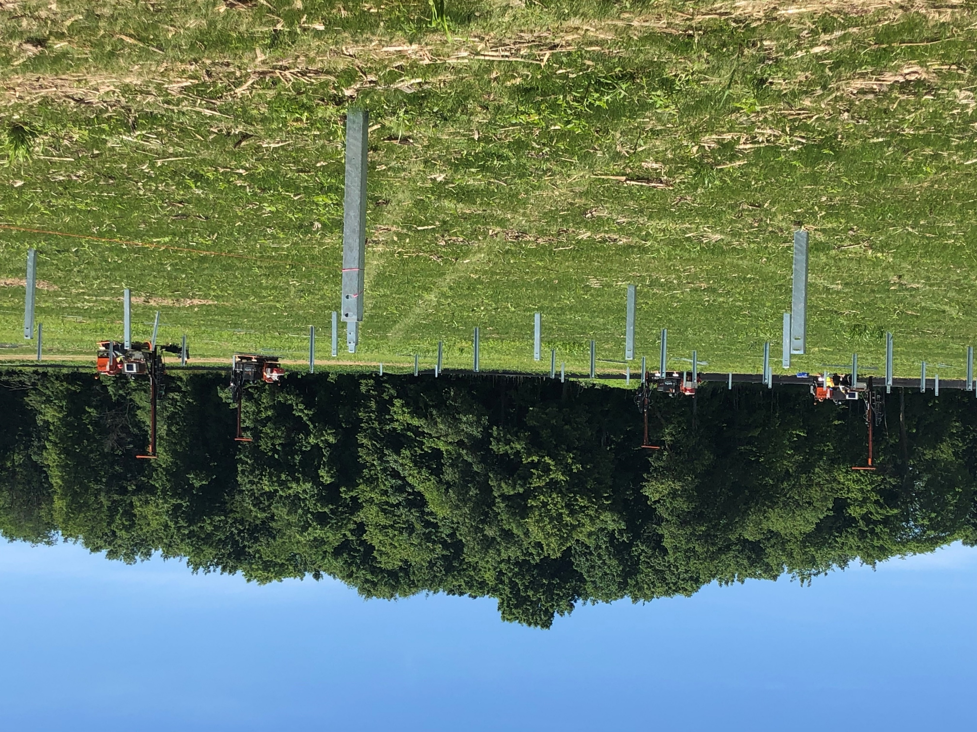
TRACKING SOLAR and Wind
PROJECTS

Slide 16
IBEW 7TH District Renewables Summary
FOCUS
Utility Scale Solar & Wind Construction Projects
PREMISE
Growing government and corporate pledges for “Net-Zero by 2050” has led to the rapid increase in the development and construction of solar fields and wind farms. A 2020 Princeton study shows that solar fields and wind farms need to be built rapidly by the 10’s to 100’s of GWs per year, up to approximately 600 GWs = three to five times today's transmission, if the 2050 goals are to be met. The target is to have enough GWs operating to supply 50% of electricity in the US, versus the 10% today.

Slide 17

APS Avangrid Avista Consumers Energy Dominion Energy DTE Energy Duke Energy | Eversource FirstEnergy Green Mountain Power Hawaiian Electric Idaho Power Madison Gas and Electric | nrg PSEG Puget Sound Energy Southern California Edison Southern Company Xcel Energy
PLAYERS
Electric utilities have pledged the net-zero goal by 2050 or similar include:

Slide 18
PROJECTIONS
Utility net-zero by 2050 goals require an $830 billion dollar investment, with ($430B) in wind and ($380B) in solar over the next 10 years.
Related Transmission
The connection of energy source to market requires construction/installation of approximately 195,000 GW-km of new transmission lines that connect to these wind/solar projects by 2030 (a 60% increase in over current capacity). [Transmission Line work will be addressed in separate report. (TMAP)]

Slide 19
Tax Credits
The most recent two-year extension of the Investment Tax Credit (ITC) for solar power and one-year extension of the Production Tax Credit (PTC) for wind power projects also boosts the chances of near-future solar and wind construction projects.

Slide 20
Tax Credit Update
Federal lawmakers on Tuesday introduced legislation that would expand the investment tax credit (ITC) to apply to standalone energy storage systems, which advocates say would further spur storage deployments and bring new technologies closer to being economic.
The Energy Storage Tax Incentive and Deployment Act would extend to both residential battery systems, as well as commercial and utility-scale energy storage projects, whether they are batteries, pumped hydropower, hydrogen, or another kind of storage technology.

Slide 21
Other Factors
While wind farms and solar fields are integral components of the goal of net zero by 2050, additional sources may include advanced nuclear, advanced geothermal, natural gas power plants with CO2 capture, bio power plants with CO2 capture, green hydrogen and ammonia combustion turbines, and energy storage. With energy storage becoming part of the new and operating wins and solar projects

Slide 22
Business Development
Each Business Development rep has reviewed the previously constructed and planned (per a 5 year look back on the Energy Acuity project information resource platform) utility scale (> 2MW) wind and solar projects in their district and was tasked with identifying:
Union signatory projects
Open shop projects
Signatory contractors performing work
Developers/EPC’s
Calculations and supporting data

Slide 23
Solar Field Installation Assumptions:
1MW requires approximately 3,500 man-hours. This includes all the Racking and Panel mounting, DC/AC wiring, combiner boxes, inverters, transformers and wiring to the T & D pole base. (Grading and post driving are not included with this number.)
The Post/Rack and Panel installation represents 60% of the 3,500 hours/MW
Solar arrays require 7 acres of land per MW. This includes the fencing and setbacks. There are 640 acres in a square mile. 1000MW (1GW) requires 7000 acres of land or 10.94 square miles.
On a Utility scale project (2MW+), an experienced panel installation crew is expected to install 100 panels per day per person (10-hour day). A five-man crew, 1 on skid steer and 4 installing panels would install 500 panels per day.

Slide 24
On Utility Scale projects over 100MW, the rule of thumb for maximum manning is 1.25 workers/MW. Max manning occurs after 30-40% into the project.
At times, Solar Developers will contact EPCs prior to project publication on Energy Acuity to get a Rough Order of Magnitude Estimate (ROM). Awards can be based on these estimates. Projects can be awarded prior to Energy Acuity publication.

Slide 25
Wind Farm Turbine Installation Assumptions:
Manpower needs are 20 Inside and 30 Outside journeymen for average wind farm.
Windfarm MW size will continue to get bigger, but acreage and manpower should stay the same – turbines are just getting bigger. Each wind turbine, regardless of MW size requires approximately one acre of land, which could include the access road. In comparison to solar, a 2MW turbine may only require 1 acre, where solar would take 14 acres. Permitting Wind Farms is far more difficult than solar permitting in the Midwest.

Slide 26
*Identified 7th District Utility Scale Solar and Wind Signatory Contractors
*This list will expand as additional signatory contractors are identified
Solar Contractors Rosendin Cupertino SCC Energy Sletten Electric | Wind Contractors Henkels & McCoy Dane Electric

Slide 27
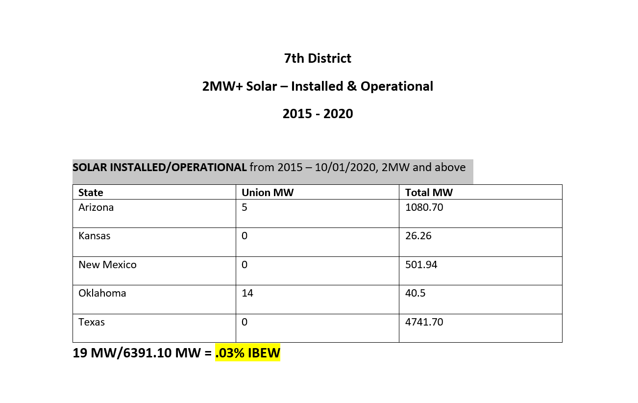

Slide 28
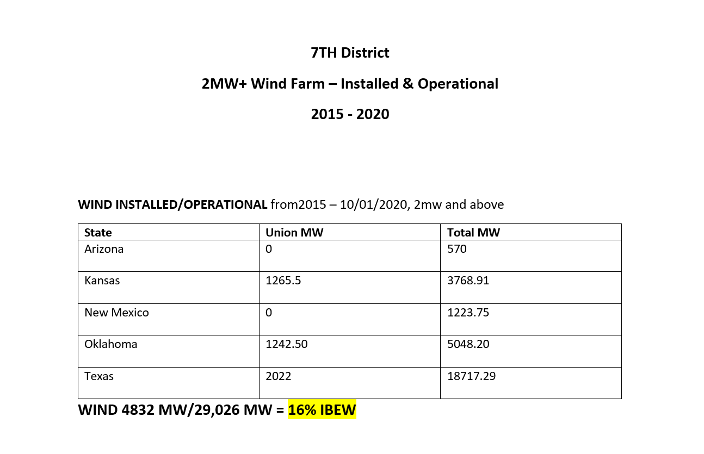

Slide 29
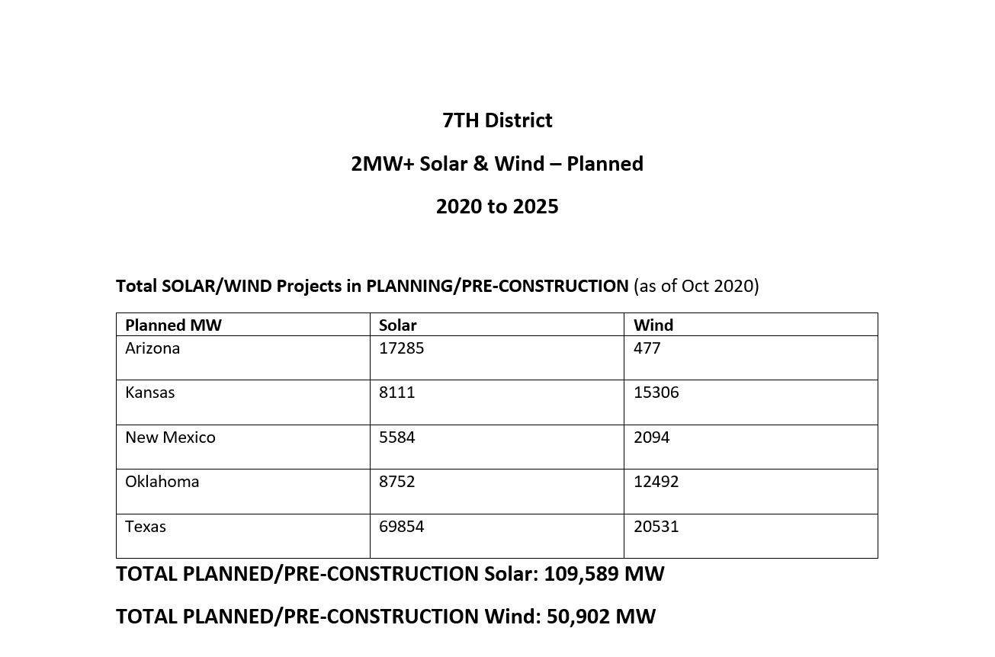

Slide 30
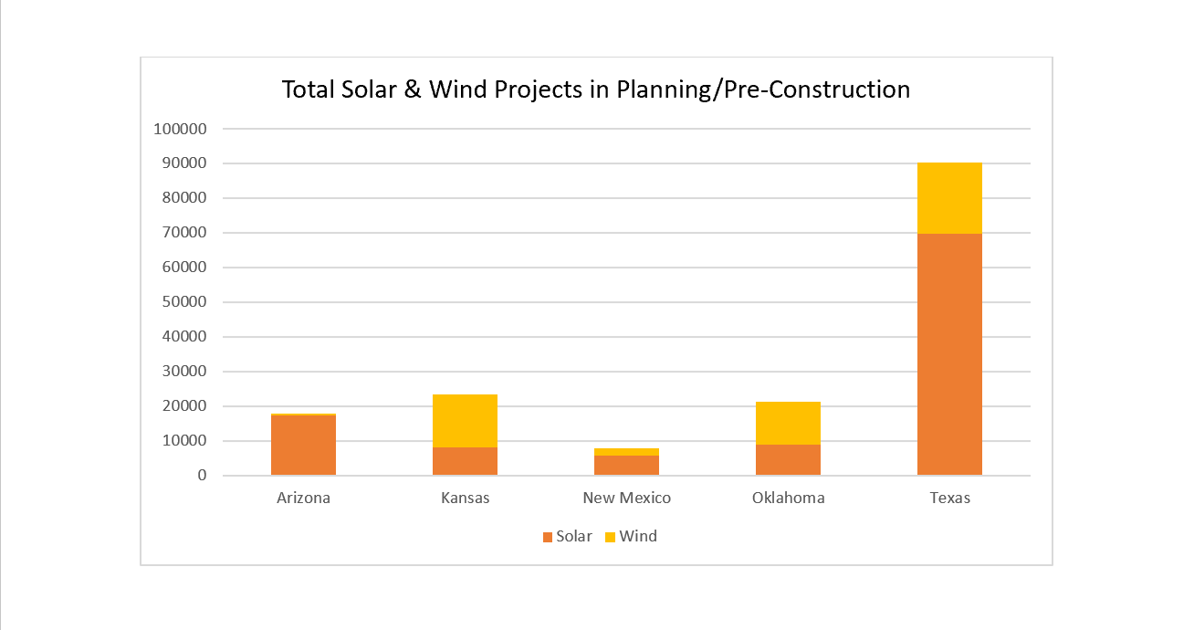

Slide 31
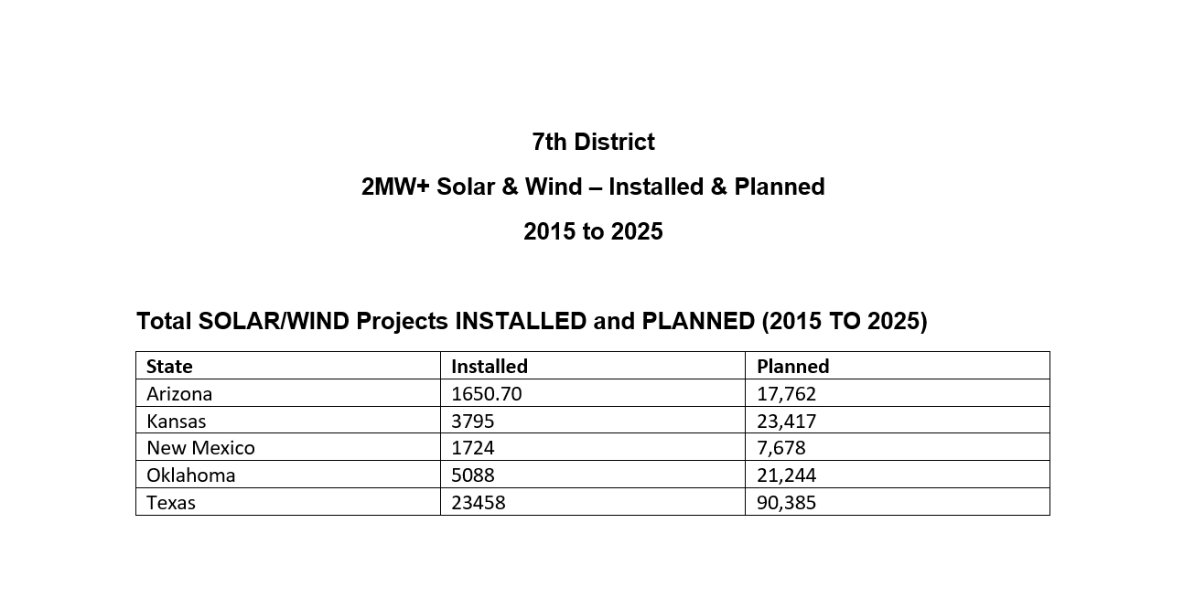

Slide 32
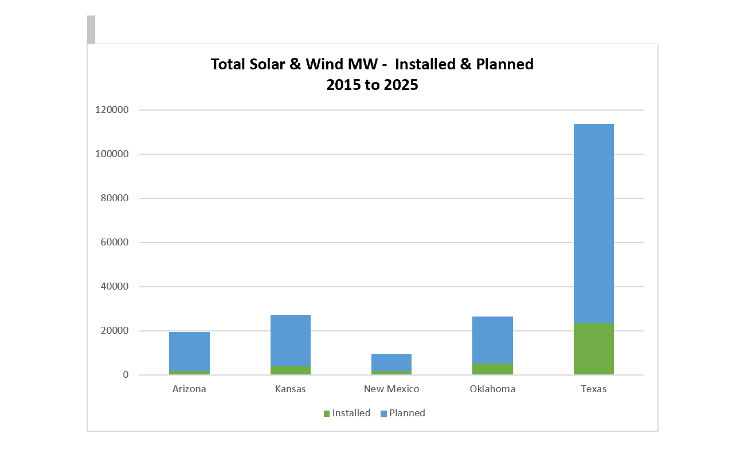

Slide 33
SUMMARY:
The planned utility scale wind and solar market is exponentially larger than the existing capacity. What is not clear is who will capture the work on those projects. The purpose of this survey is to prepare for direct and honest discussions about what strategies, and methods will produce the greatest opportunities to successfully pursue these projects and provide manhours for the IBEW and its signatory contractors. Only the subsequent implementation of an appropriate plan will affect the greatest impact to this growing sector of the electrical construction market.

Slide 34
“WE MUST FOCUS ON THE OBJECTIVE
NOT THE OBSTACALS”
WILLIAM HEARST

